Slide 1
AP Computer Science A
UNIT 9 TOPIC 1
Introduction to Inheritance
Almost spring!
AP Classroom: 9.1
Class 102
March 6, 2023
Mr. Miller
mmiller25@schools.nyc.gov

Slide 2
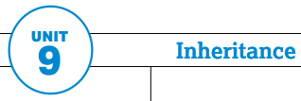
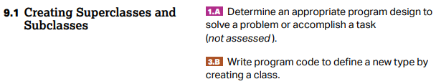
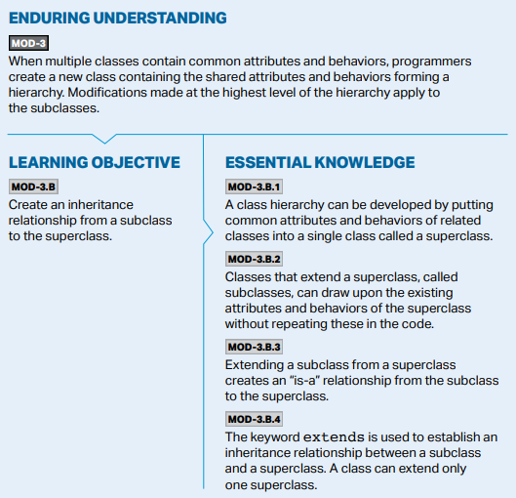
College Board Standards
Unit 9 Topic 1

Slide 3
Agenda today
Discussion and demo: intro to inheritance
U9T1 Lab
Come back and talk through lab solutions as a class

Slide 4
Introduction to Inheritance

Slide 5
What comes to mind?
Think about the everyday definition of “inheritance” -- what comes to mind?

Slide 6
Inheritance
The word “inheritance” in everyday language often conjures up ideas like:
Biological traits (eye color, etc.) that a child inherits from his or her parents.
Money left behind by the rich uncle that died (“he inherited a fortune!”)

Slide 7
Inheritance
The word “inheritance” in everyday language often conjures up ideas like:
Biological traits (eye color, etc.) that a child inherits from his or her parents.
Money left behind by the rich uncle that died (“he inherited a fortune!”)
In Java and other object-oriented programming languages, inheritance is like the first meaning above -- traits that you inherit from your parents

Slide 8
Inheritance
The word “inheritance” in everyday language often conjures up ideas like:
Biological traits (eye color, etc.) that a child inherits from his or her parents.
Money left behind by the rich uncle that died (“he inherited a fortune!”)
In Java and other object-oriented programming languages, inheritance is like the first meaning above -- traits that you inherit from your parents
Inheritance can be used to build a hierarchy of classes where “child” classes (known as subclasses) inherit attributes and behaviors from a “parent” class (known as a superclass).
An inheritance hierarchy of classes in computer science is conceptually similar to taxonomic classification in Biology

Slide 9
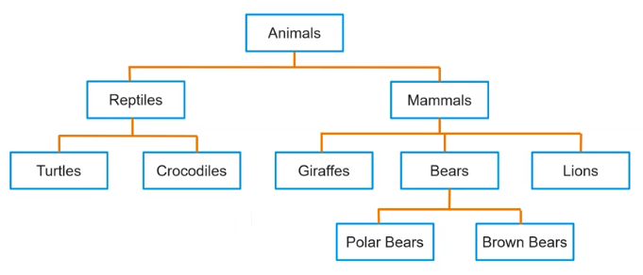
Biology analogy: taxonomy of animals

Slide 10
Biology analogy: taxonomy of animals
Similar to biology, inheritance relationships in Java allow classes to share common attributes (instance variables) and behaviors (methods) by having one class “inherit” them from another.

Slide 11
DEMO: Designing an inheritance relationship

Slide 12
Turn & Talk!
Let’s consider cars and bicycles; both are types of vehicles.
What are some behaviors that both cars and bicycles can do? (think actions)
What are some attributes/properties/characteristics/features that cars and bicycles have in common?

Slide 13
Examples
Let’s consider cars and bicycles; both are types of vehicles.
Common behaviors of both cars and bicycles
Both can move()
Both can turn()
Both can brake()
Common attributes of both cars and bicycles
Both have names
Both have wheels (note: even though cars and bicycles have a different number of wheels, the fact that they both have wheels is in common)

Slide 14
Turn & Talk!
What are some behaviors that cars do that bikes don't, and vice versa?
What are some attributes/properties/characteristics/features that cars have that bikes do not, and vice versa?

Slide 15
Examples
But while there are similarities, cars and bicycles are certainly different.
Different behaviors
Cars honk (bikes don’t honk)
Bicycles can ring bells (cars don’t have bells)
Cars can lock their doors (bicycles can’t do this)
Different attributes
Cars have an interior fabric (leather, vinyl, etc.)
Bicycles have a “gear count” (e.g. 1-, 3-, 15-, 18-, 21-gear bicycles)

Slide 16
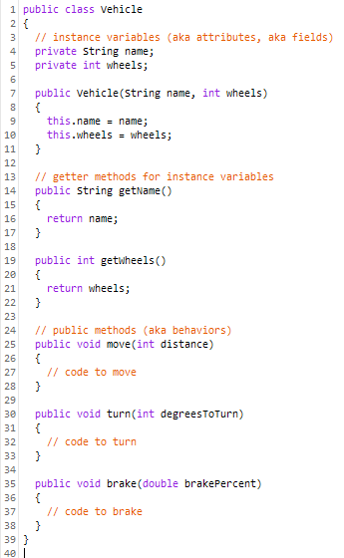
The Vehicle superclass
DEMO
We can “pull the commonalities” into a Vehicle class
(this is an example of generalization)
The common attributes (name and wheels) become instance variables (fields) in the Vehicle class
The common behaviors (move, turn, and brake) become methods in the Vehicle class

Slide 17
The Vehicle superclass
DEMO
We can “pull the commonalities” into a Vehicle class
(this is an example of generalization)
The common attributes (name and wheels) become instance variables (fields) in the Vehicle class
The common behaviors (move, turn, and brake) become methods in the Vehicle class
Spoiler Alert!
The Vehicle class will become the “parent class” (or superclass) of two “child classes” (or subclasses): Car and Bicycle

Slide 18
What about cars and bicycles?
DEMO
Now that we have the “generalized” Vehicle class, we can create two more classes named Car and Bicycle and place the attributes and behaviors that are different in those classes, but tell Java that we want them both to inherit all the commonalities from the Vehicle class
We do this using the extends keyword.
By inheriting from the Vehicle class, both Car and Bicycle inherit all public members of the Vehicle class
private members, including instance variables, are not technically inherited, so we will discuss the implications of that and how to access them from subclasses.

Slide 19
What about cars and bicycles?
DEMO
Doing this makes the Vehicle class the “parent” or superclass and the Car and Bicycle classes the “child classes.”
Importantly, a parent class can have one or more (or many!) child classes, but a child class will only have only one parent class; i.e. a class can only extend one other class in Java

Slide 20
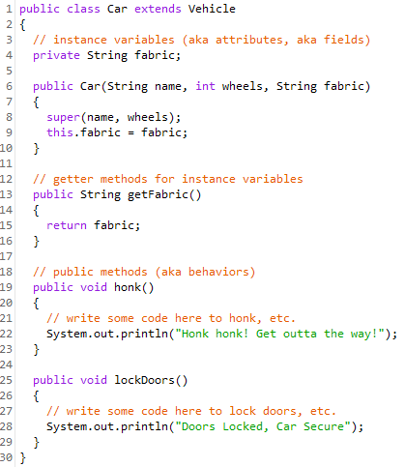
The Car subclass
DEMO
We tell Java that the Car class is inheriting from the Vehicle class with extends
The attributes specific to the Car class
We pass in the parameters for the superclass’ instance variables, in addition to the ones for the subclass --- and we call super() to initialize the instance variables in the superclass
After calling super(), we initialize any instance variables for this class
The getter methods and other behaviors (methods) specific to the Car class

Slide 21
super()
DEMO
We use a call to super() in the constructor to set the instance variables of the parent class.
Do we have to call super in the constructor? Why can’t we just set them directly? Yes you do! It’s because, technically, a subclass doesn’t inherit private members (including instance variables) and so we can’t simply do: this.name = name in the constructor of a subclass; you will get a compiler error that name is a private member.
In fact, you can’t directly set or get private instance variables in the code of a subclass -- you can do so only through getter/setter methods defined in the parent class!

Slide 22
UML diagram of this inheritance relationship
DEMO
Vehicle
name wheels
getName() getWheels() move(int distance) turn(int degreesToTurn) brake(double brakePercent)
Java Pro Tip! You do not need to know Unified Modeling Language (UML) class diagrams for the AP Exam, but it is an industry standard tool (not specific to Java) that you should be familiar with!

Slide 23
UML diagram of this inheritance relationship
DEMO
Vehicle
name wheels
getName() getWheels() move(int distance) turn(int degreesToTurn) brake(double brakePercent)
Car inherits from (extends) Vehicle
Car
fabric
getFabric() honk() lockDoors()

Slide 24
UML diagram of this inheritance relationship
DEMO
Vehicle
name wheels
getName() getWheels() move(int distance) turn(int degreesToTurn) brake(double brakePercent)
These four relationships are all equivalent and illustrated by this diagram:
Car inherits from Vehicle
Car is a subclass (child class) of Vehicle
Car extends Vehicle
Vehicle is the superclass (parent class) of Car
Car
fabric
getFabric() honk() lockDoors()

Slide 25
The “is-a” relationship
DEMO
Because the Car class is a subclass of the Vehicle class, we can say that “a Car is a type of Vehicle” or simply “a Car is a Vehicle”; this is a correct statement since all cars are vehicles!
This is known as the “is-a” relationship that exists between a subclass and its superclass.
The converse is not true, however; it is not correct to say that “a Vehicle is a Car” simply because all vehicles are not necessarily cars. A subclass IS A type of the superclass, but the superclass is NOT a type of the subclass.

Slide 26
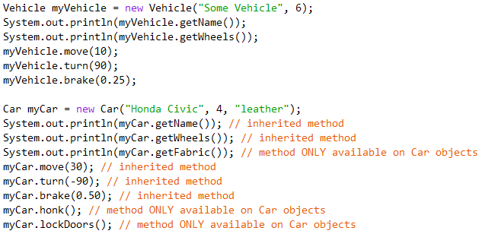
What methods can we call on a Car object?
DEMO
A Car object is a (type of) Vehicle object (because the class extends Vehicle), and so we can call any public Vehicle method on a Car object!

Slide 27

Predict!
DEMO
Which of these methods will compile and execute?

Slide 28
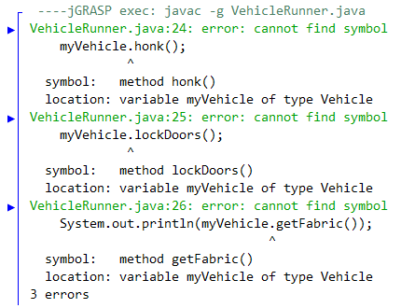
Predict!
Will these methods execute? Will they even compile?
Boom! Nope, it won’t even compile, because a Vehicle is not a Car (rather, a Car is a Vehicle), and Java knows this, so the compiler will tell you that methods specific to the Car class cannot be called on a Vehicle object (“cannot find symbol”)

Slide 29
Lab Time!
Work on the lab now (you will create the Bicycle subclass, and one other subclass of your choosing)
We will come back at the end to discuss!

Slide 30
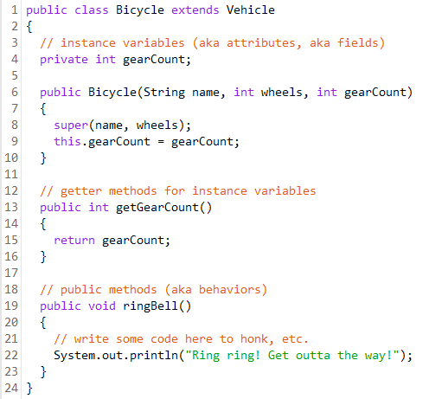
The Bicycle subclass
We tell Java that the Bicycle class is inheriting from the Vehicle class with extends
The attributes specific to the Bicycle class
We pass in the parameters for the superclass’ instance variables, in addition to the ones for the subclass --- and we call super() to initialize the instance variables in the superclass
After calling super(), we initialize any instance variables for this class
The getter methods and other behaviors (methods) specific to the Bicycle class

Slide 31
Testing the Bicycle subclass (solution to Exploration)
Quick compare!
Does the test code in your runner class main method look like this?
Bicycle myBike = new Bicycle("Citi Bike", 2, 10);
System.out.println(myBike.getName()); // inherited method
System.out.println(myBike.getWheels()); // inherited method
System.out.println(myBike.getGearCount()); // method ONLY on Bicycle objects
myBike.move(50); // inherited method
myBike.turn(45); // inherited method
myBike.brake(0.75); // inherited method
myBike.ringBell(); // method ONLY available on Bicycle objects

Slide 32
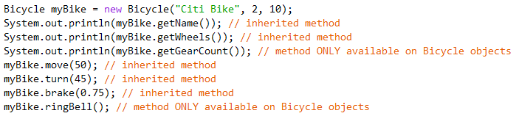
What methods can we call on a Bicycle object?
Similar to Car objects, a Bicycle object is a (type of) Vehicle object (because the class extends Vehicle), and so we can call any public Vehicle method on a Bicycle object!

Slide 33
UML diagram of this inheritance relationship
Vehicle
name wheels
getName() getWheels() move(int distance) turn(int degreesToTurn) brake(double brakePercent)
Car
fabric
getFabric() honk() lockDoors()
Bicycle
gearCount
getGearCount() ringBell()

Slide 34
UML diagram of this inheritance relationship
Vehicle
name wheels
getName() getWheels() move(int distance) turn(int degreesToTurn) brake(double brakePercent)
Car and Bicycle inherit from Vehicle
Car and Bicycle are subclasses (child classed) of Vehicle
Car and Bicycle both extend Vehicle
Vehicle is the superclass (parent class) of both Car and Bicycle
Car
fabric
getFabric() honk() lockDoors()
Bicycle
gearCount
getGearCount() ringBell()

Slide 35
UML diagram of this inheritance relationship
Vehicle
name wheels
getName() getWheels() move(int distance) turn(int degreesToTurn) brake(double brakePercent)
A superclass can be the parent of multiple subclasses...
Car and Bicycle inherit from Vehicle
Car and Bicycle are subclasses (child classed) of Vehicle
Car and Bicycle both extend Vehicle
Vehicle is the superclass (parent class) of both Car and Bicycle
...but a subclass can extend one -- and only one -- superclass; i.e. a class can only be the subclass of one other class
Car
fabric
getFabric() honk() lockDoors()
Bicycle
gearCount
getGearCount() ringBell()

Slide 36
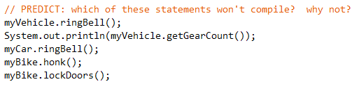
Predict!
Which of these statements won’t compile? Why not?

Slide 37
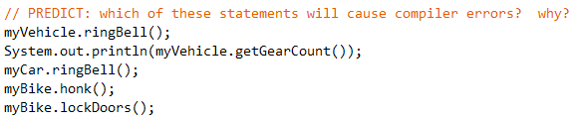
Predict!
Which of these statements will cause compiler errors? Why?
X
X
X
X
X
A Vehicle is not a Bicycle (rather, a Bicycle is a Vehicle)
A Car is not a Bicycle
A Bicycle is not a Car
ALL of these statements will cause compiler errors! NONE WILL COMPILE!

